Slide 1
Introduction to Matplotlib

Slide 2
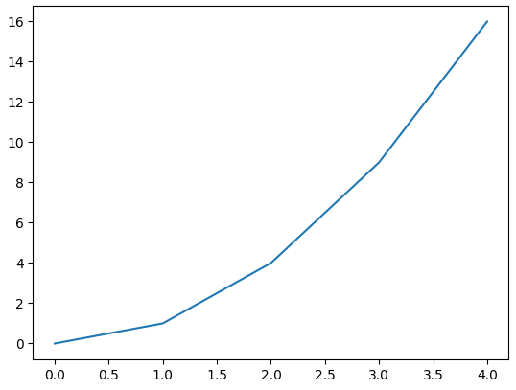
Matplotlib is a widely used Python library for creating static, interactive, and animated visualizations from data.
It provides flexible and customizable plotting functions that help in understanding data patterns, trends and relationships effectively.
Example of a Plot in Matplotlib:
import matplotlib.pyplot as plt
x = [0, 1, 2, 3, 4]
y = [0, 1, 4, 9, 16]
plt.plot(x, y)
plt.show()

Slide 3
Components of Matplotlib
Anatomy of a Matplotlib Plot: This section dives into the key components of a Matplotlib plot, including figures, axes, titles, and legends, essential for effective data visualization.
Figure: container that holds all plot elements, acting as the canvas for visualizations.
Axis: Represents x-axis and y-axis, defining limits, tick locations, and labels for data interpretation.
Lines and Markers: Lines connect data points to show trends, while markers denote individual data points in plots like scatter plots.
Title and Labels: title provides context for the plot, while axis labels describe what data is being represented on each axis.

Slide 4
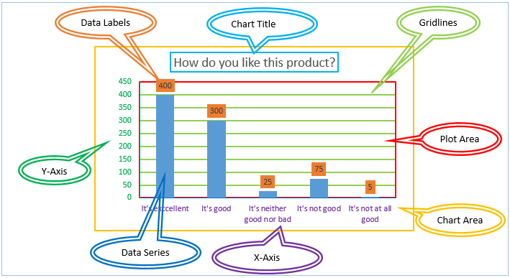

Slide 5
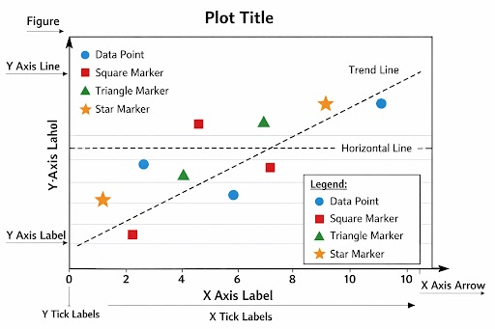

Slide 6
Matplotlib Pyplot
Pyplot is a module within Matplotlib that provides a MATLAB-like interface for making plots.
It simplifies the process of adding plot elements such as lines, images, and text to the axes of the current figure.
Import Matplotlib: Start by importing matplotlib.pyplot as plt.
Create Data: Prepare your data in the form of lists or arrays.
Plot Data: Use plt.plot() to create the plot.
Customize Plot: Add titles, labels, and other elements using methods like plt.title(), plt.xlabel(), and plt.ylabel().
Display Plot: Use plt.show() to display the plot.

Slide 7
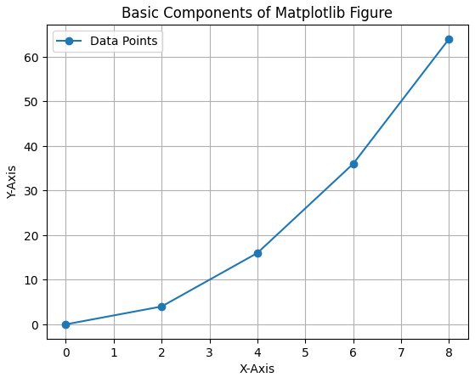
import matplotlib.pyplot as plt
x = [0, 2, 4, 6, 8]
y = [0, 4, 16, 36, 64]
fig, ax = plt.subplots()
ax.plot(x, y, marker='o', label="Data Points")
ax.set_title("Basic Components of Matplotlib Figure")
ax.set_xlabel("X-Axis")
ax.set_ylabel("Y-Axis")
plt.show()

